Slide 1
What is the cost of disregarding market feedback in transmission expansion planning?
Isaac-Camilo Gonzalez Romero¹, Sonja Wogrin¹, Tomás Gómez¹
¹ Universidad Pontificia Comillas, Instituto de Investigación Tecnológica (IIT), Madrid, Spain
*

Slide 2
Generation Expansion Planning and Transmission Expansion Planning
Proactive
TEP
GEP

Slide 3
Generation and Transmission Expansion Planning
TSO (TEP)
Deregulated market
GENCOs (GEP)

Slide 4
Research Question
If instead of assuming a traditional cost minimization approach, a TSO foresees strategic market outcomes, can this be beneficial for society?
What can be the results of considering distinctive policy objectives?

Slide 5
Mathematical Formulation

Slide 6
Centralized Planning (CP)
Single Optimization Problem
Minimizes Total Cost
Decision Variables:
Binary transmission expansion
Continuous generation expansion
Operation Variables
Assumptions:
Inelastic Demand
Perfect Competition
Perfect Information
Notes:
jhfhh

Slide 7
Bilevel Proactive Equilibrium (BP)
Upper Level
TSO or social planner (decides TEP)
1) Min Cost (CM-BP)
2) Max Welfare (WM-BP)
GENCOs
(decide GEP and operation)
Maximize Benefits
SO
(decides flows)
Maximizes Congestion Rents
Consumers
(decide demand)
Maximize Demand Utility
Lower
Level
Market Clearing Condition
GENCOs can behave both Perfectly Competitive (PC) or Cournot Oligopoly (CO)
Notes:
jhfhh

Slide 8


MIP Reformulaiton
Upper Level
Objective Function:
Max Welfare / Min Cost
Subject to:
$$θ_{g}: \frac{∂λ}{∂{vProd}_{g}}$$
$$PC : θ_{g}= 0$$
$$CO : θ_{g}=\frac{1}{Slope}$$
Dual Feasibility Constraints
Complementarity Constraints
Primal Feasibility Constraints
product & consumption limits
spillage & reservoir limits
reservoir balance
wind availability limits
line capacities, DC flow
positive demand
MIP linearization
Disjunctive Constraints
Lower Level
KKT Conditions
Market Clearing Condition

Slide 9
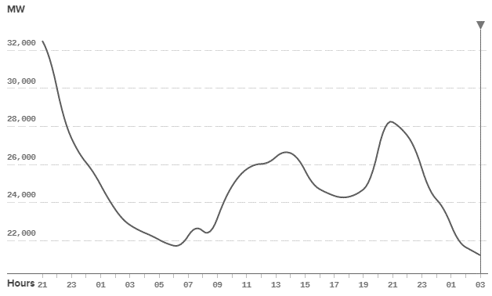
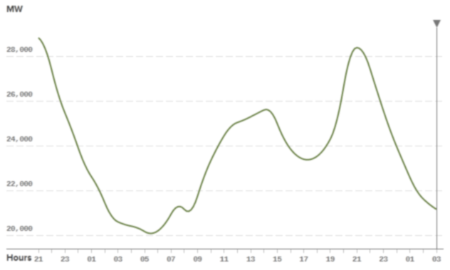
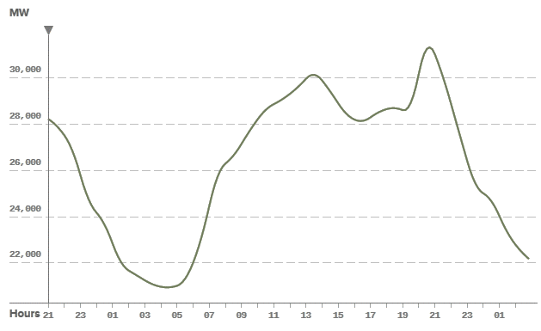
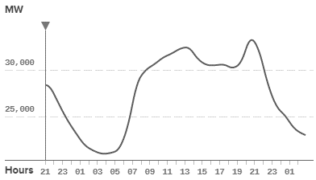
Linked Representative Periods
Hourly Year Demand
RP1
RP2
Representative Days
RP3
RP4
D. A. Tejada-Arango, M. Domeshek, S. Wogrin, and E. Centeno, “Enhanced Representative Days and System States Modeling for Energy Storage Investment Analysis,” IEEE Trans. Power Syst., vol. 8950, no. c, pp. 1–1, 2018.

Slide 10
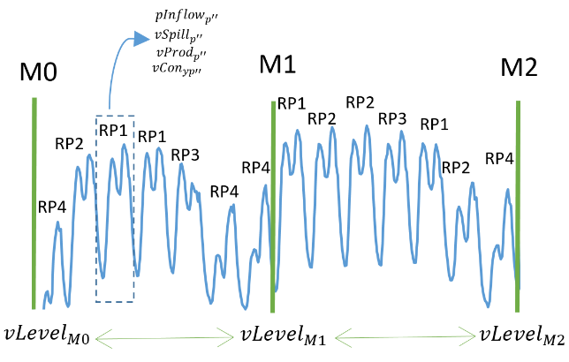
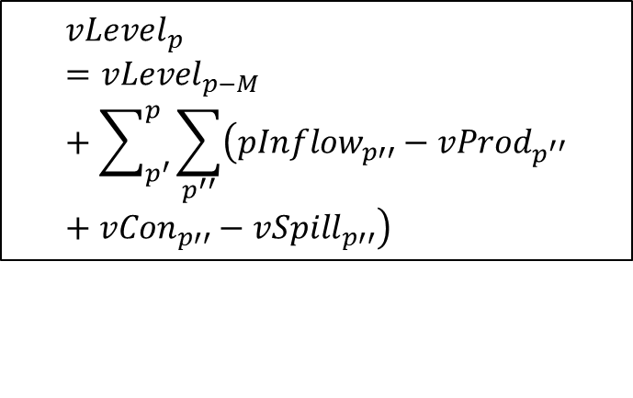
Storage Representation
$${vCon}_{}$$
$${vProd}_{p}$$
Intraday constraints
$$pInflow$$
$${vLevel}_{p}={vLevel}_{p−1}+{pInflow}_{p}−{vProd}_{p}+{vCon}_{p}−{vSpill}_{p}∀p,$$
$${vSpill}_{}$$
Interday constraints
$${vLevel}_{p}={vLevel}_{p−M}+\sum_{p^{′}}^{p}{\sum_{p^{′′}}{\left({pInflow}_{p′′}−{vProd}_{p^{′′}}+{vCon}_{p′′}−{vSpill}_{p′′}\right)}}$$
D. A. Tejada-Arango, M. Domeshek, S. Wogrin, and E. Centeno, “Enhanced Representative Days and System States Modeling for Energy Storage Investment Analysis,” IEEE Trans. Power Syst., vol. 8950, no. c, pp. 1–1, 2018.

Slide 11
CASE STUDY

Slide 12
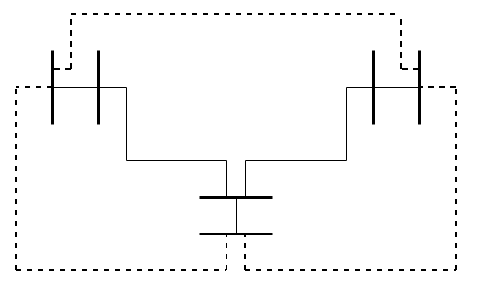
Input Data
Six-Node System
5 existing lines
5 existing generation units
CCGT
Coal
Nuclear
Hydro
Battery
1 candidate generator
CCGT
Time Scope: 1 year
2 representative days
168 hours window
Deterministic Case
Elastic Demand
4
3
5
6
2
1

Slide 13
Cases
Policy Objectives
Regret
CP
BP
CM-BP
WM-BP
vs
vs

Slide 14
RESULTS

Slide 15
Distinctive Policy Objectives Economic Results
 | Units | CM |  | WM
TEP | Lines | 6_1/6_3 | < | ALL
GEP | MW | 437.6 | > | 410.3
Welfare | (M€) | 1758.4 | < | 1896
Total Cost | (M€) | 367.5 | < | 440
Total Demand | (TWh) | 253.2 | < | 278
(274) [168]
(35.6) [32.7]
(54) [54]
4
3
5
6
(15) [15]
2
(112.2) [114.1]
1
(138) [127]
We consider Perfect Competition in the lower level

Slide 16
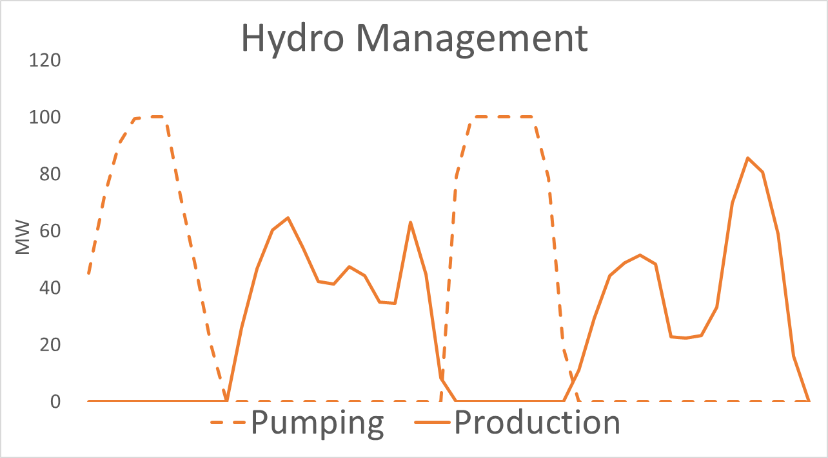
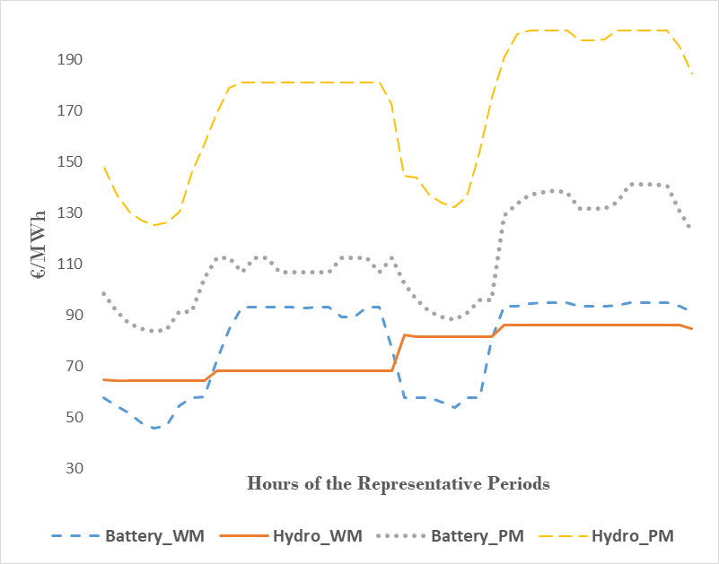
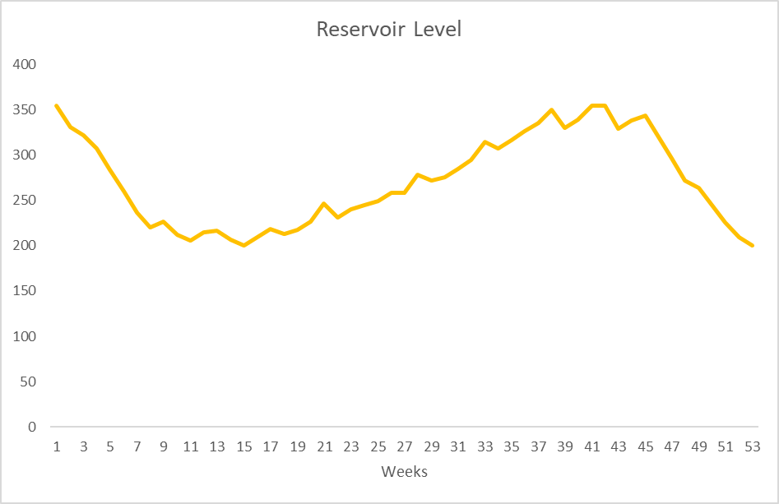
Distinctive Policy Objectives Planning and Prices
Hourly Prices
Reservoir Level
Weeks

Slide 17
Regret Computation
Bilevel Proactive Cost Min
Elastic Demand- Cournot
BP
Demand
Centralized Planning Inelastic Demand Perfect Comp
“Naïve CP”
Regret = Actual CP – BP
TEP
Lower Level Problem
Elastic Demand - Cournot
“Actual CP”

Slide 18
Regret Results
 | Units | BP | Naïve CP | Actual CP
TEP | Lines | 6-3 | 6-1/6-3 | 6-1/6-3
GEP | MW | 214.8 | 220.9 | 214.2
Welfare | M€ | 809.2 | 587 | 809.2
Total Cost | M€ | 225.9 | 131.8 | 235.6
Total Demand | TWh | 119.3 | 119.3 | 119.4
Regret | M€ |  |  | 9.8
Relative Regret | M€/TWh |  |  | 0.08
Cost Regret = 4%
Welfare Regret = 0%
No Regret with perfect competition

Slide 19
CONCLUSIONS
Distinctive policy objectives can result in different equilibria even if the market is perfectly competitive.
Disregarding strategic market feedback can result in sub-optimal planning results that lead to higher total cost or lower welfare.

Slide 20
REFERENCES
[1] P. Pisciella, M. Bertocchi, and M. T. Vespucci, “A leader-followers model of power transmission capacity expansion in a market driven environment,” Comput. Manag. Sci., vol. 13, no. 1, pp. 87–118, 2016.
[2] D. A. Tejada-Arango, M. Domeshek, S. Wogrin, and E. Centeno, “Enhanced Representative Days and System States Modeling for Energy Storage Investment Analysis,” IEEE Trans. Power Syst., vol. 8950, no. c, pp. 1–1, 2018.
[3] S. Jin, S. M. Ryan, and A. Sets, “A Tri-Level Model of Centralized Transmission and Decentralized Generation Expansion Planning for an Electricity Market — Part I,” vol. 29, no. 1, pp. 132–141, 2014.
[4] S. K. K. Ng, J. Zhong, and C. W. Lee, “A Game-Theoretic Study of the Strategic Interaction between Generation and Transmission Expansion Planning,” 2009 IEEE/PES Power Syst. Conf. Expo., pp. 1–10, 2009.
[5] D. Pozo, J. Contreras, and E. Sauma, “If you build it, he will come: Anticipative power transmission planning,” Energy Econ., vol. 36, pp. 135–146, 2013.
[6] S. You, S. W. Hadley, M. Shankar, and Y. Liu, “Co-optimizing generation and transmission expansion with wind power in large-scale power grids—Implementation in the US Eastern Interconnection,” Electr. Power Syst. Res., vol. 133, pp. 209–218, 2016.

Slide 21
Questions
This work was supported by Project Grant ENE2016-79517-R, awarded by the Spanish Ministerio de Economía, Industria y Competitividad.
https://stexem.iit.comillas.edu/

